Slide 1



Title Handwritten Digit Recognition using Convolutional Neural Network ( CNN )
Lokesh Santosh Gaikwad
FBS ID : FRN-04D1023/005

Slide 2
Outline of Project
Data Preprocessing
Model Architecture
Training the Model
Evaluation and Testing
The trained CNN model should achieve high accuracy on the test set, demonstrating
its ability to generalize well to unseen handwritten digits.
The model can be used in real-world applications where digit recognition is required

Slide 3
Problem Statement
Objective
Develop a CNN model to recognize handwritten digits from the MNIST dataset.
Achieve high accuracy in classifying digits (0-9).

Slide 4
Introduction about Data :
Data Overview
MNIST Dataset:
Description :
A large database of handwritten digits commonly used for training various
image processing systems.
Training set: 60,000 images
Test set: 10,000 images
Image dimensions: 28x28 pixels
Classes: 10 (digits 0-9)

Slide 5
Convolutional Neural Network (CNN)
CNNs are a class of deep neural networks specifically designed for processing structured grid data like images.
They consist of convolutional layers that automatically and adaptively learn spatial hierarchies of features from input images.
Layers:
Input Layer: 28x28x1
Convolutional Layers: Extract features
Max-Pooling Layers: Down-sample the image
Fully Connected Layers: Classify the features
Output Layer: Softmax activation for digit classification

Slide 6
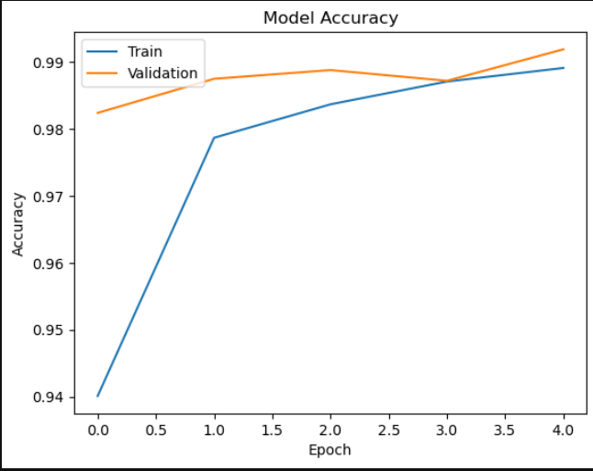
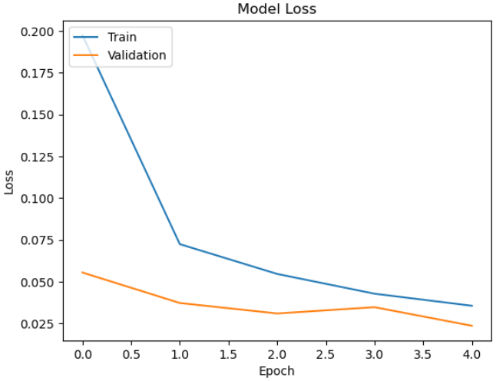
Model Evaluation
Evaluation Metrics:
Accuracy : 0.9919000267982483
Loss : 0.023

Slide 7
Conclusion
Summary:
Successfully developed and trained a CNN model for handwritten digit recognition.
Achieved high accuracy on the model.

